Slide 1
Analyzing Key Drivers of Maternal Mortality: A Socioeconomic and Healthcare Perspective
TEAM 7
(Palle , Sunny)

Slide 2
INTRODUCTION
We focused on analyzing how different demographic factors, socioeconomic factors etc effect Maternal Death Rates in USA.
The goal is to identify key drivers of maternal mortality and improve maternal health outcomes.

Slide 3
DATASET
AHRQ : Social Determinants of Health Database (2019-2020)
Developed by the Agency for Healthcare Research and Quality (AHRQ)
Provides county-level data on social , economic and healthcare factors.
Enables analysis of social determinants and their impact on health outcomes.
It serves as a valuable resource for public health professionals, policymakers and researchers.

Slide 4
DEPENDENT VARIABLE
Maternal Mortality Rate

Slide 5
Independent Variables
Percentage of Female Population
Percentage of Population Aged 15–17
Percentage of Population Aged 18–29
Percentage of Population Aged 30–44
Percentage of American Indian/Alaska Native Population
Percentage of Asian Population
Percentage of Black/African American Population
Percentage of Hispanic Population
Percentage of Native Hawaiian/Pacific Islander Population
Percentage of Other Races
Percentage Not in Labor Force (16+)
Median Household Income
Percentage Below Poverty Threshold (1.37x)
Unemployment Rate (16+)
Number of Nurse Midwives
Distance to Nearest Obstetrics Department
Number of Health Centers
Number of Hospitals with Obstetric Services
Number of Hospitals with ICU Facilities
Number of Hospitals with Emergency Departments
Percentage of Government-Owned Hospitals

Slide 6
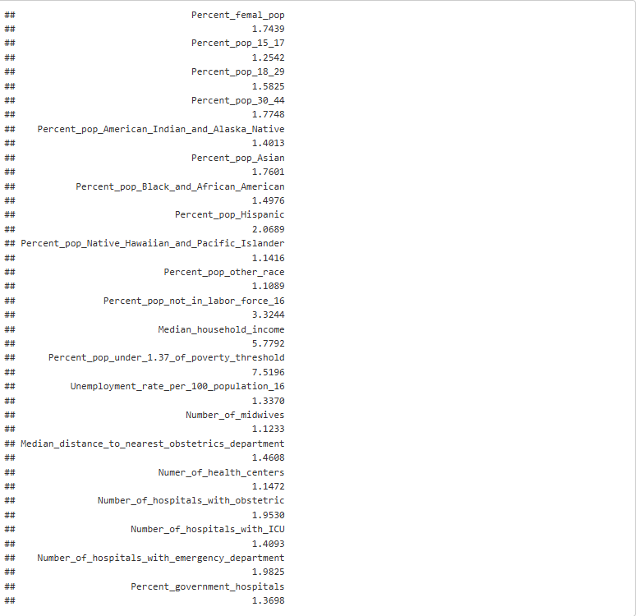
VIF
Percent_pop_other_race (1.1089) and Number_of_midwives (1.1233) have low VIFs, indicating minimal multicollinearity
Variables like Percentage of population under 1.3t times of the poverty threshold (7.5196) and Median_household_income (5.7792) have high VIFs, suggesting multicollinearity.
Variables like pop_other_race and Number of midwives have low VIF’s indicating minimal collinearity.
Other variables have medium collinearity

Slide 7
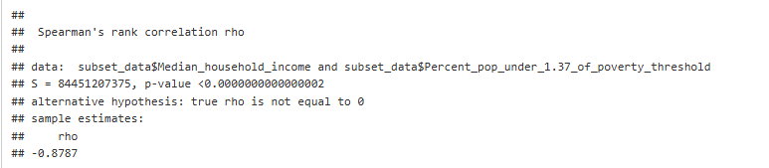
Spearman Correlation Test
ρ = -0.8787, indicating a strong negative correlation between the two variables. As one variable increases, the other tends to decrease significantly
The p-value is extremely small indicating the correlation is statistically significant.
The Spearman Correlation confirms that Median Household Income and Percentage of population under 1.37 times the poverty threshold are negatively correlated.

Slide 8
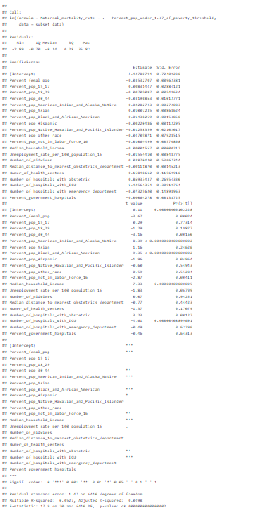
Linear Regression
The coefficients for percentage of American Indians and and the Percentage of African Americans are are statistically significant and positive, meaning that counties with higher percentage of American Indian and Black have higher maternal mortality rate.
The coefficient for Median Household Income is statistically significant and negative, indicating that Higher median household income is associated with a lower maternal mortality rate.
The coefficient for Number of Hoapitals with ICU is statistically significant and negative, suggesting that More hospitals with ICUs are associated with a lower maternal mortality rate.
The coefficient for Number of Hospitals with obstetric is statistically significant and positive, which might reflect referral bias, where areas with higher maternal mortality attract more obstetric services.
Adjusted R Squared : 0.0498

Slide 9
Random Forest Regression
Finding the best model based on RMSE value
From the image we can see that the best model uses 100 trees, 21 randomly selected predictors, min node size 1 and max depth 20.

Slide 10
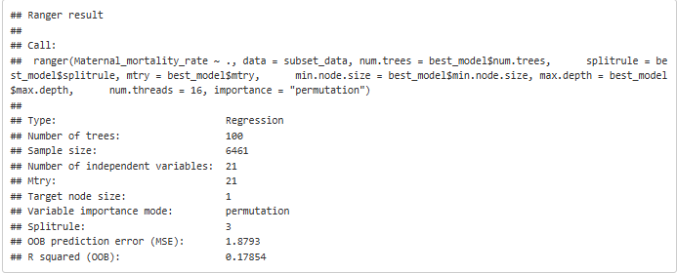
Refitting the Final Random Forest Model
Number of Trees: 100
Predictors: 21
Sample Size: 6461
Min Node Size: 1
Split Rule: Maxstat
OOB Prediction Error (MSE): 1.8793
R-squared (OOB): 0.17854

Slide 11
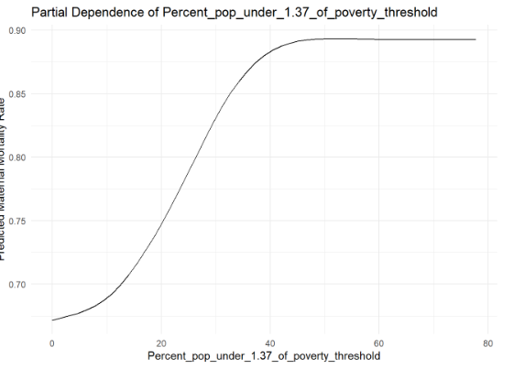
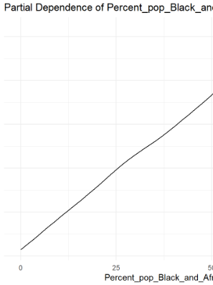
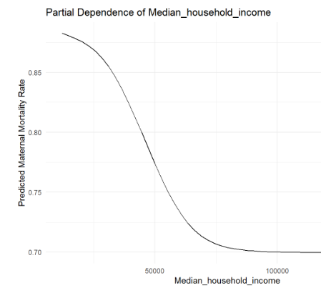
Partial Dependence of Key feature
Higher percentages of Black and African American populations are associated with increased maternal mortality rates
Higher percentages of the population living below 1.37 times the poverty threshold are associated with increased maternal mortality rates
Higher median household income is associated with a significant decrease in maternal mortality rates

Slide 12
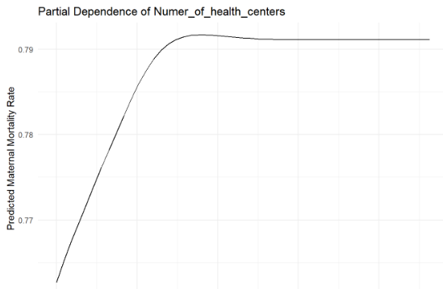
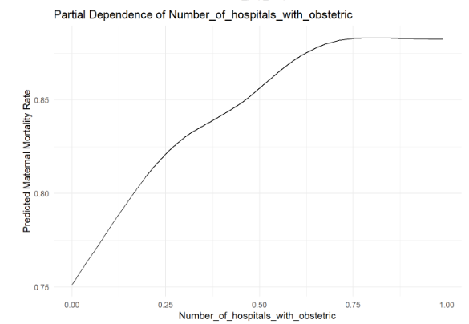
Higher the number of Health Care Centers lower is the Maternal Mortality Rate
as the number of hospitals with obstetric services increases, maternal mortality rates slightly decrease

Slide 13
CONCLUSION
Higher income reduces maternal mortality, while poverty increases it significantly.
Proximity to obstetric care and availability of specialized hospitals reduce mortality risks.
Proximity to obstetric care and availability of specialized hospitals reduce mortality risks.

